Slide 1
Pyogenic Meningitis
Dr Ravideep

Slide 2
Meningitis is defined as inflammation of membranes surrounding the brain and spinal cord.
Meningoencephalitis is inflammation of meninges and brain cortex.

Slide 3
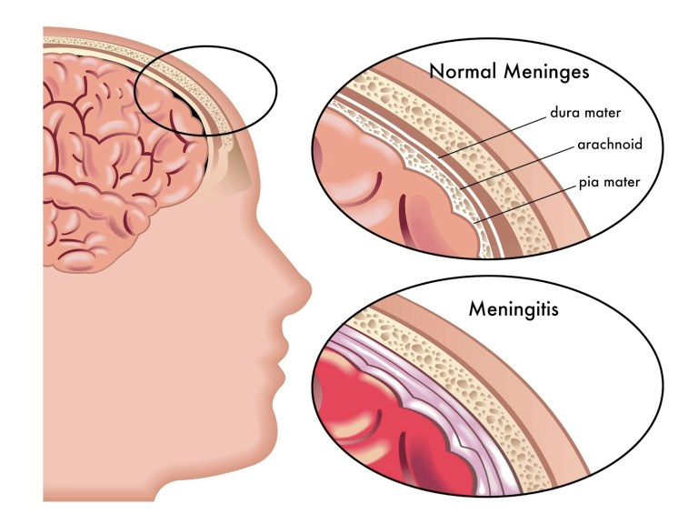

Slide 4
Incidence and Etiology
Commonest in Neonates and Infancy because of poor immunity and phagocytic functions.
More frequent in infant Males
Greater risk during 6-12 months and 95% cases occur between 1 month and 5 years.

Slide 5
Causative organisms
Neonates | Escherichia coli Streptococcus pneumoniae Salmonella species Pseudomonas aeuroginosa Staphylococcal aureus
3 months - 3 years | Hemophilus influenzae type b Streptococcus pneumoniae Meningococci ( Neisseria meningitides )
>2 years | Streptococcus pneumoniae Neisseria meningitides
Diminished host response , Malignancies , Children on Immunosuppressive drugs | More susceptible to develop meningitis by fungi , Listeria monocytogenes and mycoplasma

Slide 6
Pathogenesis
Infection spreads hematogenously to meninges from distant foci , e.g. pneumonia , empyema , pyoderma and osteomyelitis.
Rarely , the infection may extend from contiguous septic foci , e.g. infected paranasal sinuses , mastoiditis , fracture of base of skull.
Anatomic and congenital defect can also cause infection , e.g. myelomeningocele

Slide 7
Pathology
Leptomeninges are infiltrated with inflammatory cells
Cortex of brain shows deem , exudate and proliferation of microglia
Ependymal cells are destroyed and purulent exudate collects at base of brain , most marked in interpeduncular and schismatic cisterns
Exudates may block the foramina of Luschka and Magendie - Hydrocephalus
Thrombophlebitis of cerebral vessels may occur leading to infarction and neurologic sequelae

Slide 8
Pathology
Fulminating illness may occur in case of meningococcal meningitis and death may occur in few hours because of endotoxic shock.
Bacterial pathogens on destruction liberate cell wall and membrane active components ( trichroic acid , endotoxins , peptidoglycans ).
In response host cells produce tumor necrosis factor , cytokines and platelet aggravating factor. Their interaction with BBB and neurons results in extensive host damage.
Cerebral edema ( vasogenic ) occurs due to endothelial cell injury or cytotoxins.

Slide 9
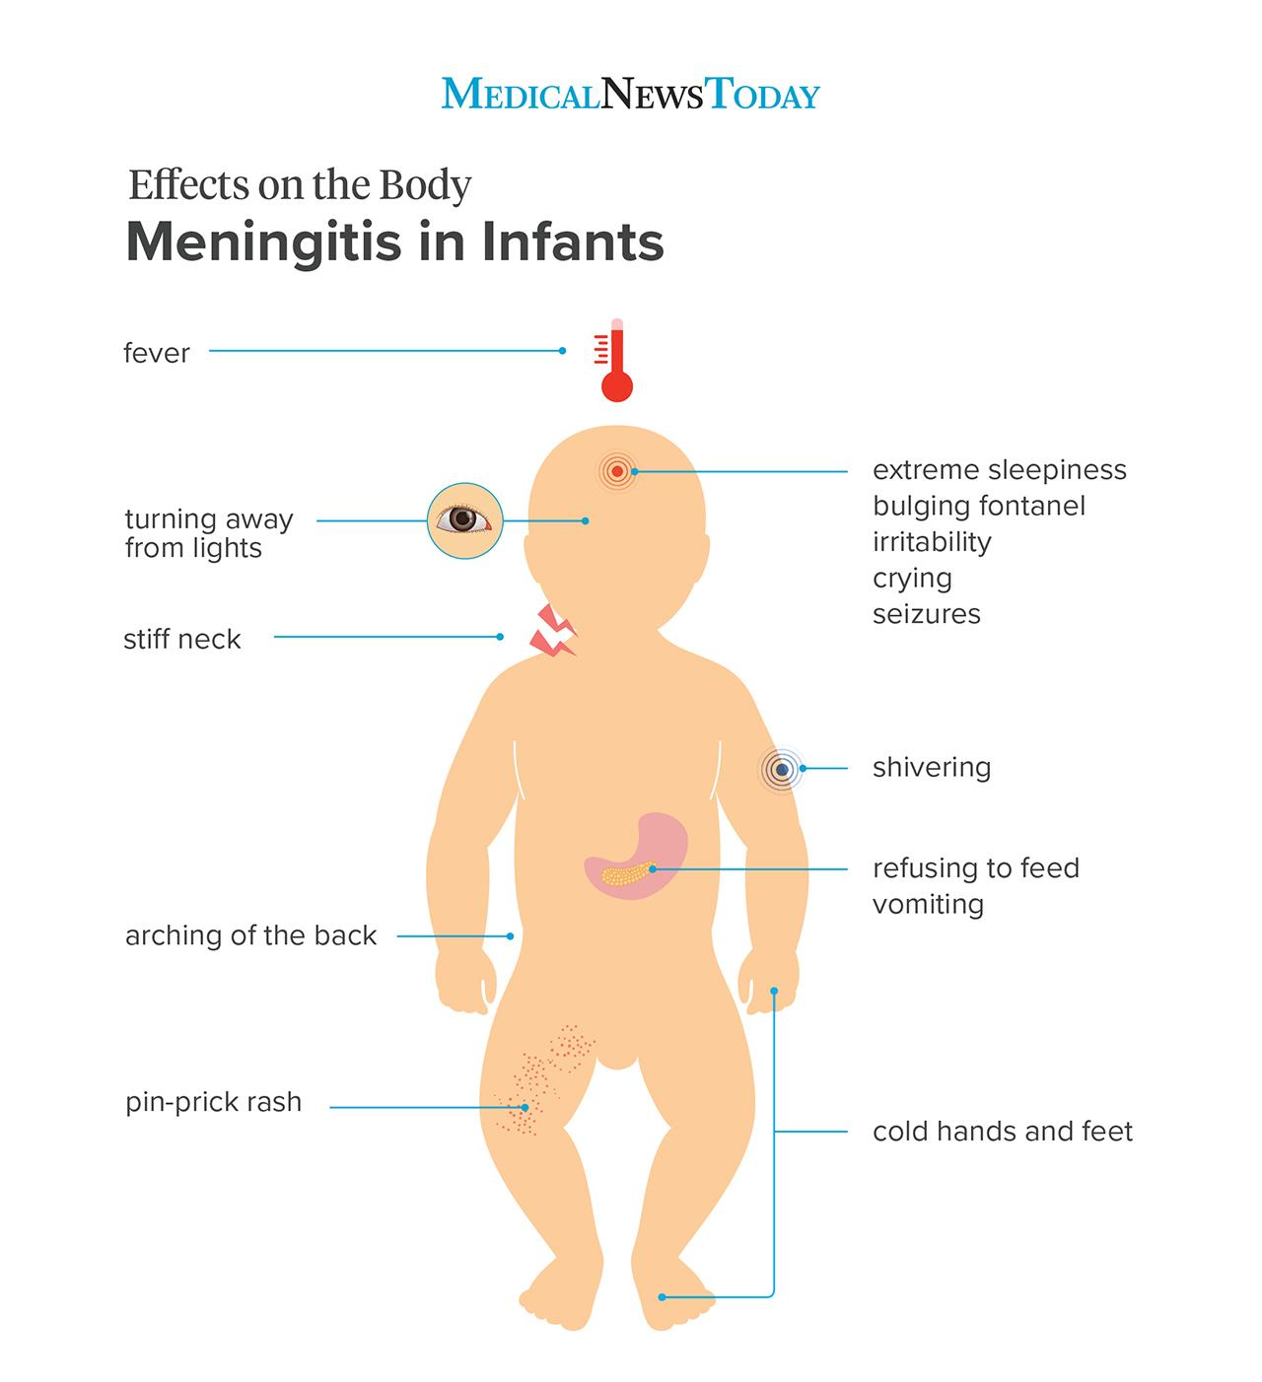
Clinical features
Neonates and Infants
Infective illness in mother , prolonged rupture of membranes or difficult delivery put the newborn at risk
Premature infants have low level of antibodies
Predisposing factor is spina bifida or dermal sinus

Slide 10
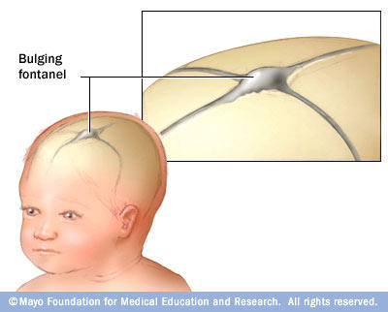
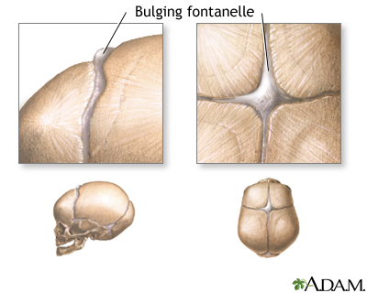

Slide 11
Older children
Classic signs preceded by upper respiratory or GIT symptoms
High grade fever , head ache and projectile vomiting
Seizures are common
Increased CSF pressure leads to bulging fontanelle and diastasis of sutures

Slide 12
Neck stiffness , positive kerning’s sign and brudzinski’s sign
Cranial nerve palsies and papilledema
Hemiplegia in cases late reported , ataxia may also be present
Patient may be comatose or semi comatose

Slide 13
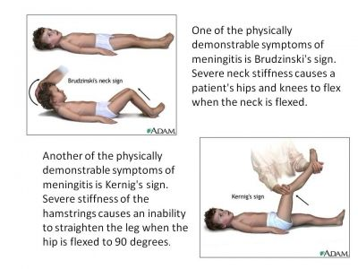

Slide 14
Meningococcal meningitis is characterised by presence of features of Waterhouse Friderichsen syndrome ( adrenal insufficiency , hypotension , shock and coma) occurs due to haemorrhage and necrosis in adrenal glands.
Otitis media and mastoiditis is likely to lead streptococcal and pneumococcal meningitis. Exudates are common on cortex and subdural effusion is usual complication.

Slide 15
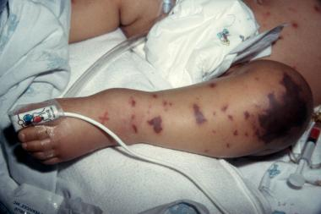
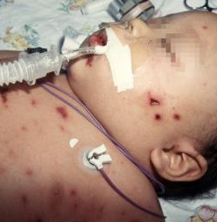
Meningococcemia

Slide 16
Staphylococcal meningitis is likely following umbilical sepsis , pyoderma or septicaemia . In older children it follows otitis media , mastoiditis ,sinus thrombosis , pneumonia , arthritis and septic lesions of scalp or skin.
Hemophilus influenzae type b meningitis is frequent between ages 3 and 12 months. Convulsions are common . Residual auditory deficit is a common complication .

Slide 17
Investigations
Lumbar puncture
CSF pressure should be noted , funds checked for papilledema
Xanthochromia due to bilirubin from haemorrhage or increased protein
CSF glucose should be compared to blood glucose , CSF glucose is 2/3 of blood glucose
In CSF of neonates normally there are unto 30 lymphocytes and 150mg/dl protein
Gram stain is important to recognise the causative agent

Slide 18
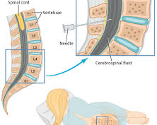
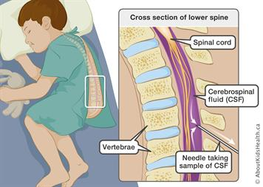

Slide 19
Gram staining
Meningococci | Gram negative intracellular diplococci
Pneumococci | Gram positive diplococci
H.Influenzae | Gram negative cocobacilli
E.Coli | Gram negative bacilli

Slide 20
CSF findings in various CNS disorders
Condition | Color | Leucocytes | Protein (mg/dl) | Glucose (mg/dl)
Normal | Clear | 0-5 60-70% Lymphocytes | 20-45 | >50 or 75% of Blood glucose
Acute Bacterial Meningitis | Opalscent to purulent | 100-20000 PMN predominate | 100-500 | <40 May be none
TB meningitis | Opalscent | 10-2000 PMN early but lymphocyte later | >50 | <40 May be none
Viral encephalitis | Clear | 5-500 Mostly lymphocytes PMN early | 30-150 | 30-70

Slide 21
Lumbar puncture
Contraindications
Increased ICP especially with focal neurological deficits
Severe cardio pulmonary compromise
Infection of skin overlying the site of LP
Bleeding or clotting disorder

Slide 22
CSF culture
The yield of CSF culture decreases soon after antibiotic therapy has been started
PCR more sensitive in patients treated by antibiotics

Slide 23
Blood culture
H.influenzae and S.pneumoniae
Blood counts
Total and DLC- generally there is leucocytosis with predominant polymorphs
X ray Chest
To rule out TB and Pneumonia

Slide 24
CT scan
Indications
Prolonged comatose condition
Seizures 72 hours after onset of treatment
Continued excessive irritability
Focal neurological findings
Persistently abnormal CSF findings
Relapse or recurrence

Slide 25
Rapid Diagnostic Tests
Concurrent electrophoresis
Latex particle agglutination
ELISA to detect bacteria antigen in CSF
CSF lactate level
Latex agglutination and ELISA have sensitivity and specificity of almost 80%
PCR - Herpes simplex , Enteroviruses , Meningococci & TB.

Slide 26
Differential Diagnosis
Meningism - no neurological signs and CSF normal
Aseptic meningitis - CSF pressure elevated , mild pleocytosis and moderate increase in protein with near normal sugar. No organisms are cultured
TB meningitis
Viral encephalitis
Cryptococcal meningitis- immunocompromised host
Subarachnoid haemorrhage - CT scan

Slide 27
Treatment
Initial Empiric Therapy
Third generation cephalosporin such as Ceftriaxone(100-150mg/kg/day) or Cefotaxime(200mg-300mg/kg/day)
Ampicillin ( 200mg/kg) and chloramphenicol (100mg/kg/day) for 10-14 days is also effective
All antibiotics are administered IV
If fever or Meningeal signs persists after 48 hours of therapy , a LP should be repeated and choice of antibiotics reviewed

Slide 28
Treatment
Specific antimicrobial therapy
Meningococcal or Pneumococcal meningitis : Penicillin 400-500,000 units/kg/day q 4hr. Cefotaxime ( 150-200mg/kg/day q 8 hr) or ceftriaxone(100-150mg/kg/day q 12 hr ) are also effective.
H.influenzae meningitis : ceftriaxone or cefotaxime is used as single agent. Combination of Ampicillin and chloramphenicol less preferred
Staphylococcal : vancomycin ( 15-20mg/kg IV q6hr ) is the treatment of choice in case of MRSA. Addition of rifampicin increases CSF penetrance and efficacy of these drugs

Slide 29
Treatment
Specific antimicrobial therapy
Listeria : Ampicillin ( 300mg/kg/day q 6 hr) and aminoglycoside (gentamicin , amikacin or netilmycin ) preferred
Gram negative bacilli : Cefotaxime , Ceftazidime or ceftriaxone , or combination of ampicillin and amino glycoside may be used.
Pseudomonas : combination of ceftazidime and amino glycoside is used. Ticarcilin in place of ceftazidime may be used. Meropenem(40mg/kg IV q8hr) or cefepime are effective agents ,if above drugs fail.

Slide 30
Treatment
Duration
Generally show quick improvement in days
Treatment is for 10-14 days
Staphylococcal and gram negative infections extended to 3 weeks
Routine LP at the end of therapy not recommended.

Slide 31
Treatment
Steroid therapy
No role in neonatal meningitis
Dexamethasone at dose of 0.15mg/kg IV q 6hr for 2-4 days initiated shortly before or along with first dose of antibiotic
Helps to reduce incidence of residual neurological complications , such as sensorineural deafness , hydrocephalus and behavioural disturbances
Especially useful in H.influenzae meningitis

Slide 32
Treatment
Symptomatic Therapy
Cerebral edema & Increased ICP : Head end elevated about 30 degrees. Osmotic diuresis with 0.5mg/kg of mannitol as a 20% solution is administered IV every 4-6 hr for maximum of 6 doses
Convulsions : diazepam 0.3mg/kg ( Max 5mg) IV followed by phenytoin 15-20mg/kg loading dose and continued at a dose of 5mg/kg IV or PO. Antiepileptic drugs can be stopped after 3 months
Fluid and electrolyte homeostasis : Maintanence fluids are given , hypotonic fluids avoided.

Slide 33
Treatment
Symptomatic therapy
Inappropriate ADH secretion : Fluid restriction and diuretics
Hypotension : treated with IV fluids and vasopressors such as dopamine and dobutamine
Nursing care : oral cavity , eyes ,bladder and bowel should be taken care of. Bed sores are prevented by frequent posture change and by using soft foam mattress or air cushion

Slide 34
Complications
Increased ICP | Cranial Nerve Palsies
Seizures | Stroke
Ataxia | SIADH
Subdural effusions | Spastic paraparesis
Blindness | Cerebral infarcts
Long term neurologic sequelae | Epilepsy
Deafness | Spasticity

Slide 35
Complications
Subdural empyema is managed by drainage of subdural space along with intensive antibiotic therapy , subdural effusions generally resolve spontaneously
Hydrocephalus may occur in acute phase and generally regresses. Ventriculoatrial or ventriculoperitoneal shunt is rarely required

Slide 36
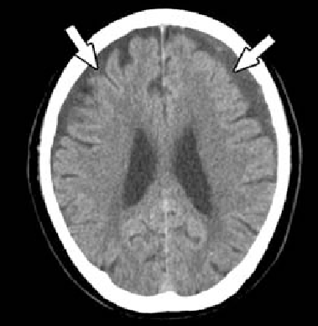
Subdural effusion

Slide 37
Prevention
Vaccination
Vaccines available against S.pneumoniae , N.meningitides and H.influenzae type b
Pneumococcal polysaccharide vaccine available
Meningococcal vaccine for high risk groups

Slide 38
Antibiotic prophylaxis
Meningococcal : Rifampicin at a dose of 10mg/kg given 12 hourly for 2 days
H.influenzae : Rifampicin at dose of 20mg/kg/day for 4 days for household contacts and patient
S.pneumoniae : no prophylaxis

Slide 39
Follow Up
Auditory evaluation should be carried out at the time of discharge and 6 weeks later

Slide 40
THANK YOU
Dr Ravideep (+917416878888)
Email : ravideepy@gmail.com

